Slide 1
Lecture 12
Application Signing

Slide 2
Introduction
Application Signing, or Code Signing means to know which applications originate with the owner of a signing certificate, and ensure that code has not been modified since it was signed.
We will discuss Application Signing in 3 Parts:-
1. Public Key Encryption and Cryptographic (Digital) Signing.
2. How Signatures Protect Software Users, Publishers, and Secure Communications.
3. Signing an Application.

Slide 3
Public Key Encryption and Cryptographic Signing
Public key cryptography depends on this mathematical principle:- it is easy to multiply large prime numbers together, but it is extremely difficult to make factors the product of large primes.
It means that product of two large prime numbers can be made as public rule of multiplication but to make factors the product of large prime numbers by your private knowledge.
So, documents encrypted with the public key are secure if only the possessor of the private key can decrypt them.

Slide 4
Public Key Encryption and Cryptographic Signing
The steps to sign a document are:
1. Compute a unique number from the document.
2. Encrypt the number with the signer’s private key. This is the signature.
The steps to verify a signed document are:
1. Compute a unique number from the document.
2. Decrypt the signature using the public key.
Verifying a signature also verifies that the signature was not copied to a different document. Signatures are unalterably tied to the document from which they were created.

Slide 5
How Signatures Protect Software Users, Publishers, and Secure Communications
As a user of computer software, It would be nice to know where my software comes from and that it has not been modified to my device.
Signed applications enable you to have this confidence. This is a form of confidence based on cryptographic(digital) signatures.
When you browse the Web you already rely on cryptographic signatures to trust that the ecommerce site (Snapdeal.com) have no any set up to take your money and run.
In the case of ecommerce, the client verifies a signature of the server’s certificate using a public key from a certificate authority.
Your browser comes with keys from several certificate authorities which used for this purpose.
In signing Android software, the signing certificate does not have to come from a certificate authority. It can be created by the software publisher.
Digital signatures on Android are also used during application upgrades to ensure that an application upgrade should be permitted to access files created by an earlier version of the application and the upgrading application is not actually a malicious application trying to steal user data.

Slide 6
Signing an Application
Cryptographic Signing is managed by the SDK tools.
Debug certificates:-
When we created an Android project and run it in an emulator or device, you may have noticed you didn’t need to create a certificate and your application is installable on an Android handset, but the fact that all Android code must be signed. This is achieved by the use of an automatically created debug certificate.
In Android, you will find a file named debug.keystore. Using the keytool command, you can find out what is inside this file:
keytool -list -keystore debug.keystore
When you are prompted for a password, enter android. You will see output that looks like this:
Keystore type: JKS
Keystore provider: SUN
Your keystore contains 1 entry
androiddebugkey, May 13, 2010, PrivateKeyEntry,
Certificate fingerprint (MD5): 95:04:04:F4:51:0B:98:46:14:74:58:15:D3:CA:73:CE

Slide 7
Signing an Application
Debug certificates:-
The keystore type and provider indicate the keystore is a Java keystore, compatible with the Java Cryptography Architecture.
The keytool command is part of the JDK.
The last line produced by the list option in keytool is a certificate fingerprint. This is a unique number generated from a key.
This certificate expires in a short interval that it cannot be used to distribute Android software other than for testing.

Slide 8
Signing an Application
Creating a self-signed certificate:-
In Eclipse, select the project of the application you want to sign for release, and select the File→Export command.
Select the Android folder and select Export Android Application and click on the Next button.

Slide 9
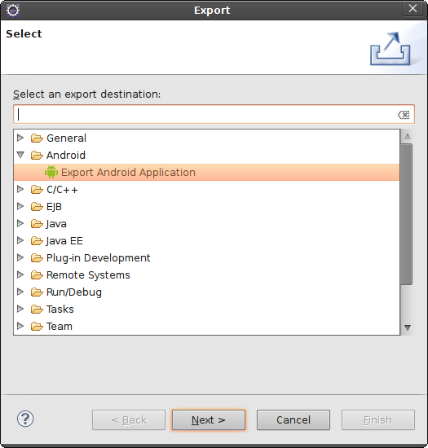
Signing an Application

Slide 10
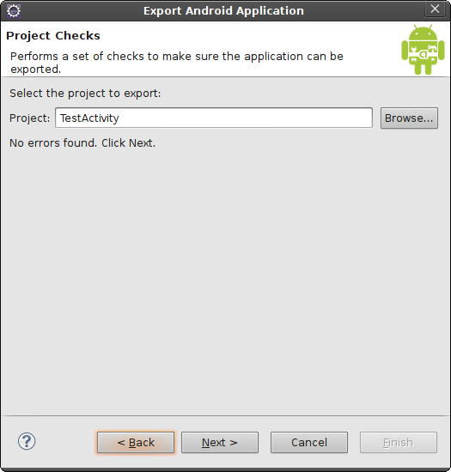
Signing an Application

Slide 11
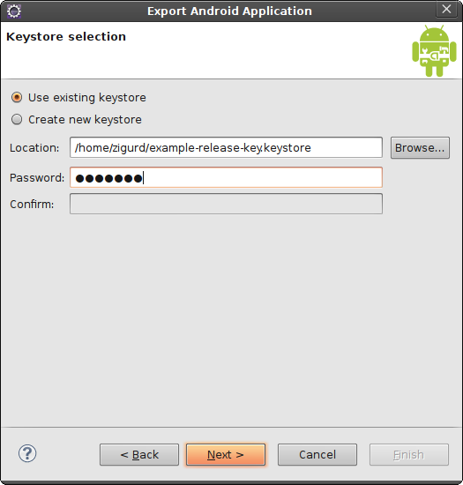
Signing an Application

Slide 12
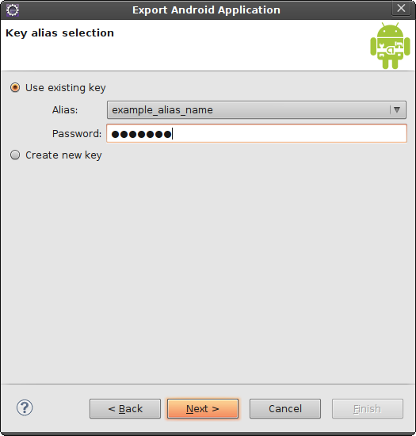
Signing an Application

Slide 13
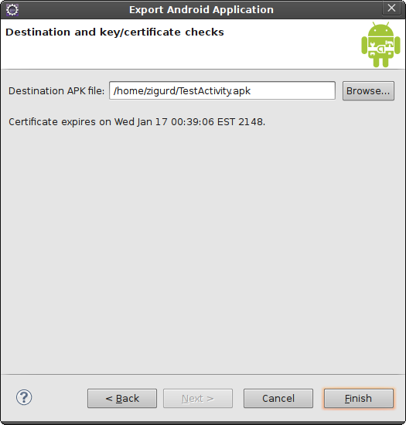
Signing an Application

